Slide 1
MAX-DOAS and MWR daily report
2018 .11. 12

Slide 2
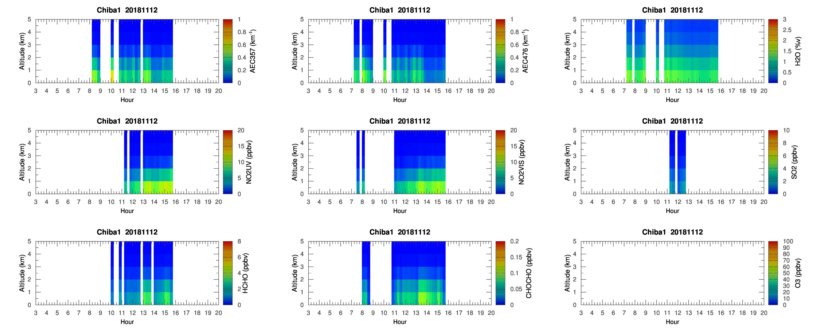
max_chiba1_20181112_ddm1

Slide 3
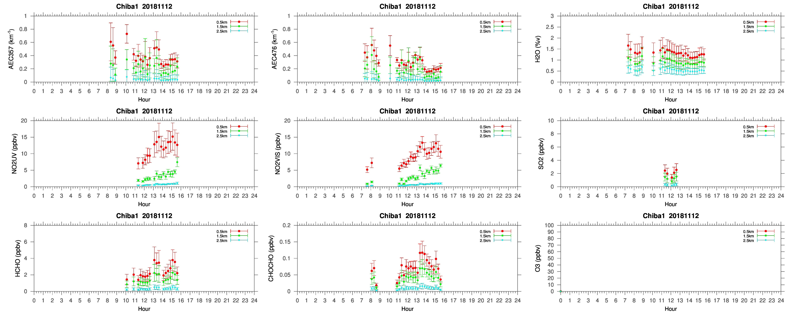
max_chiba1_20181112_dem1

Slide 4
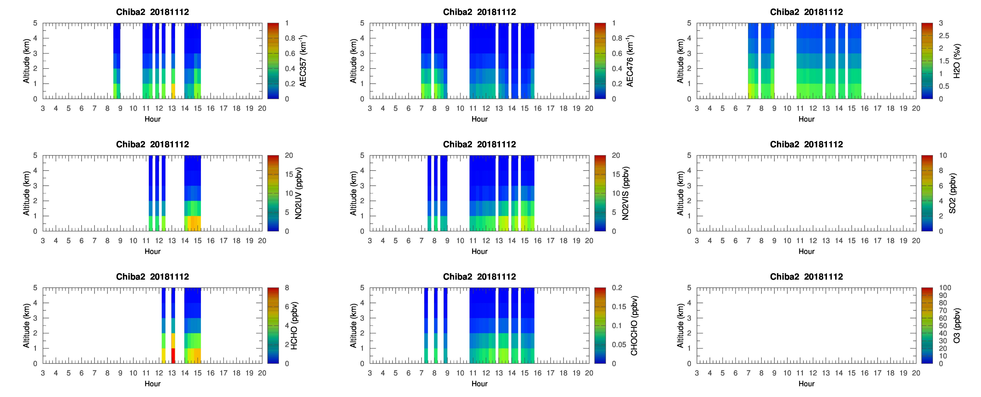
max_chiba2_20181112_ddm1

Slide 5
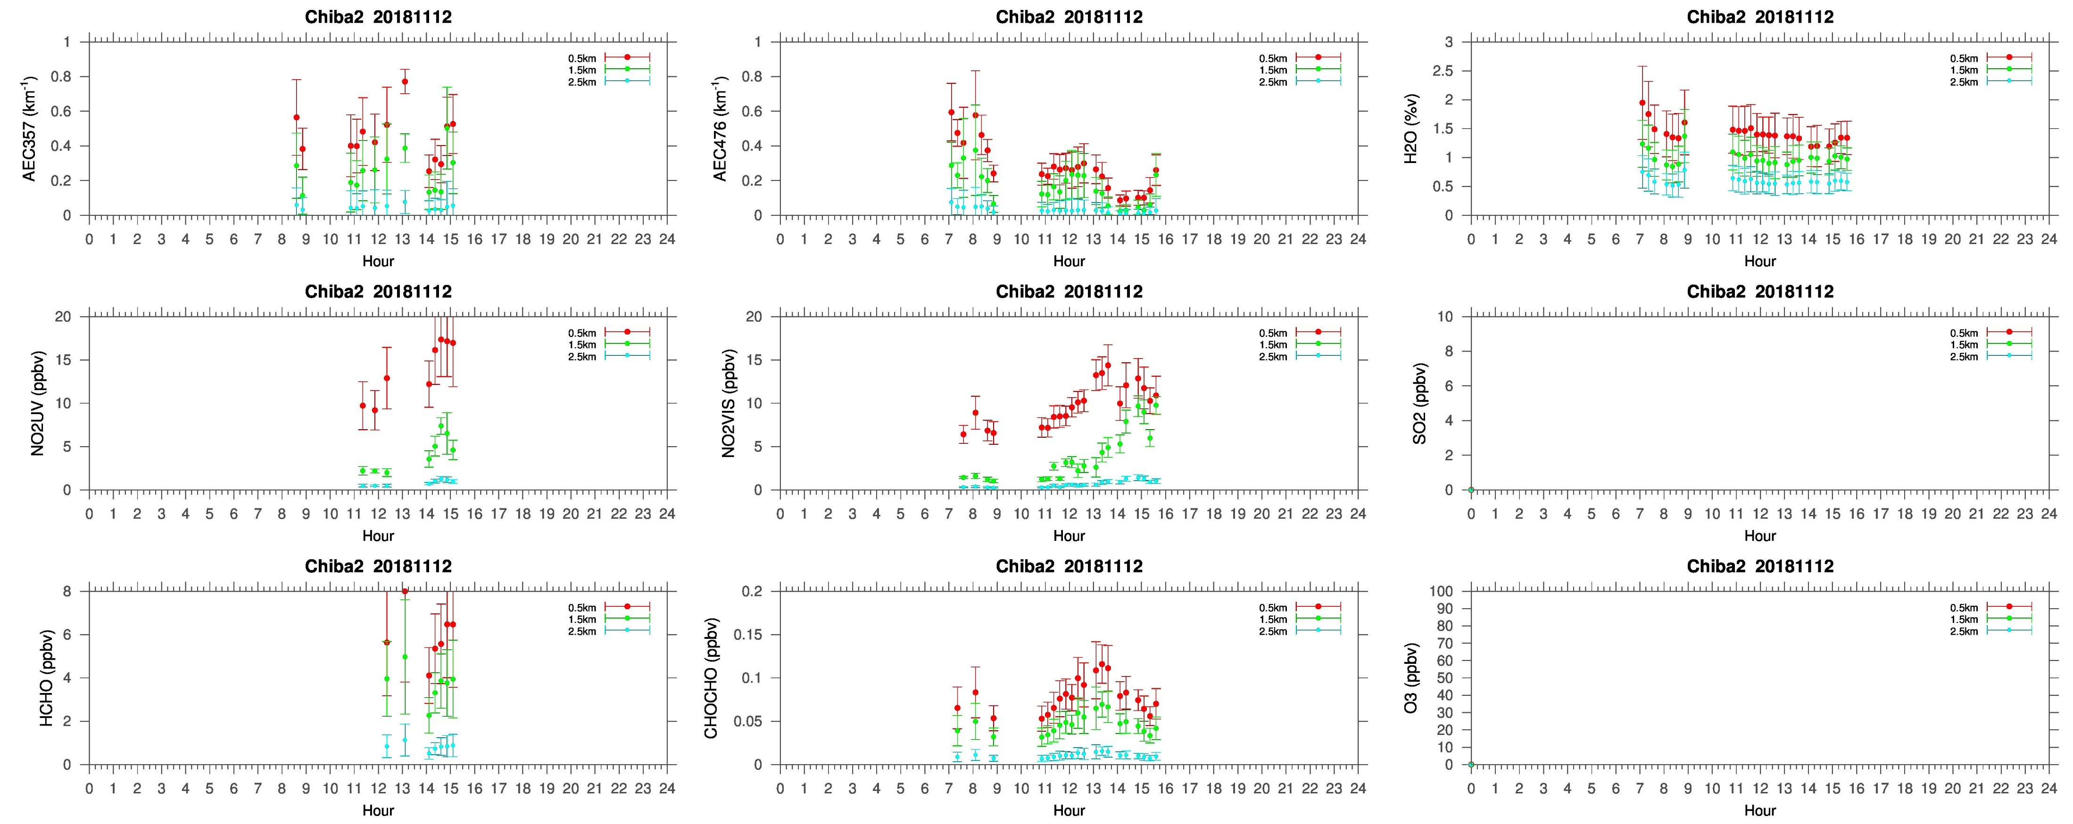
max_chiba2_20181112_dem1

Slide 6
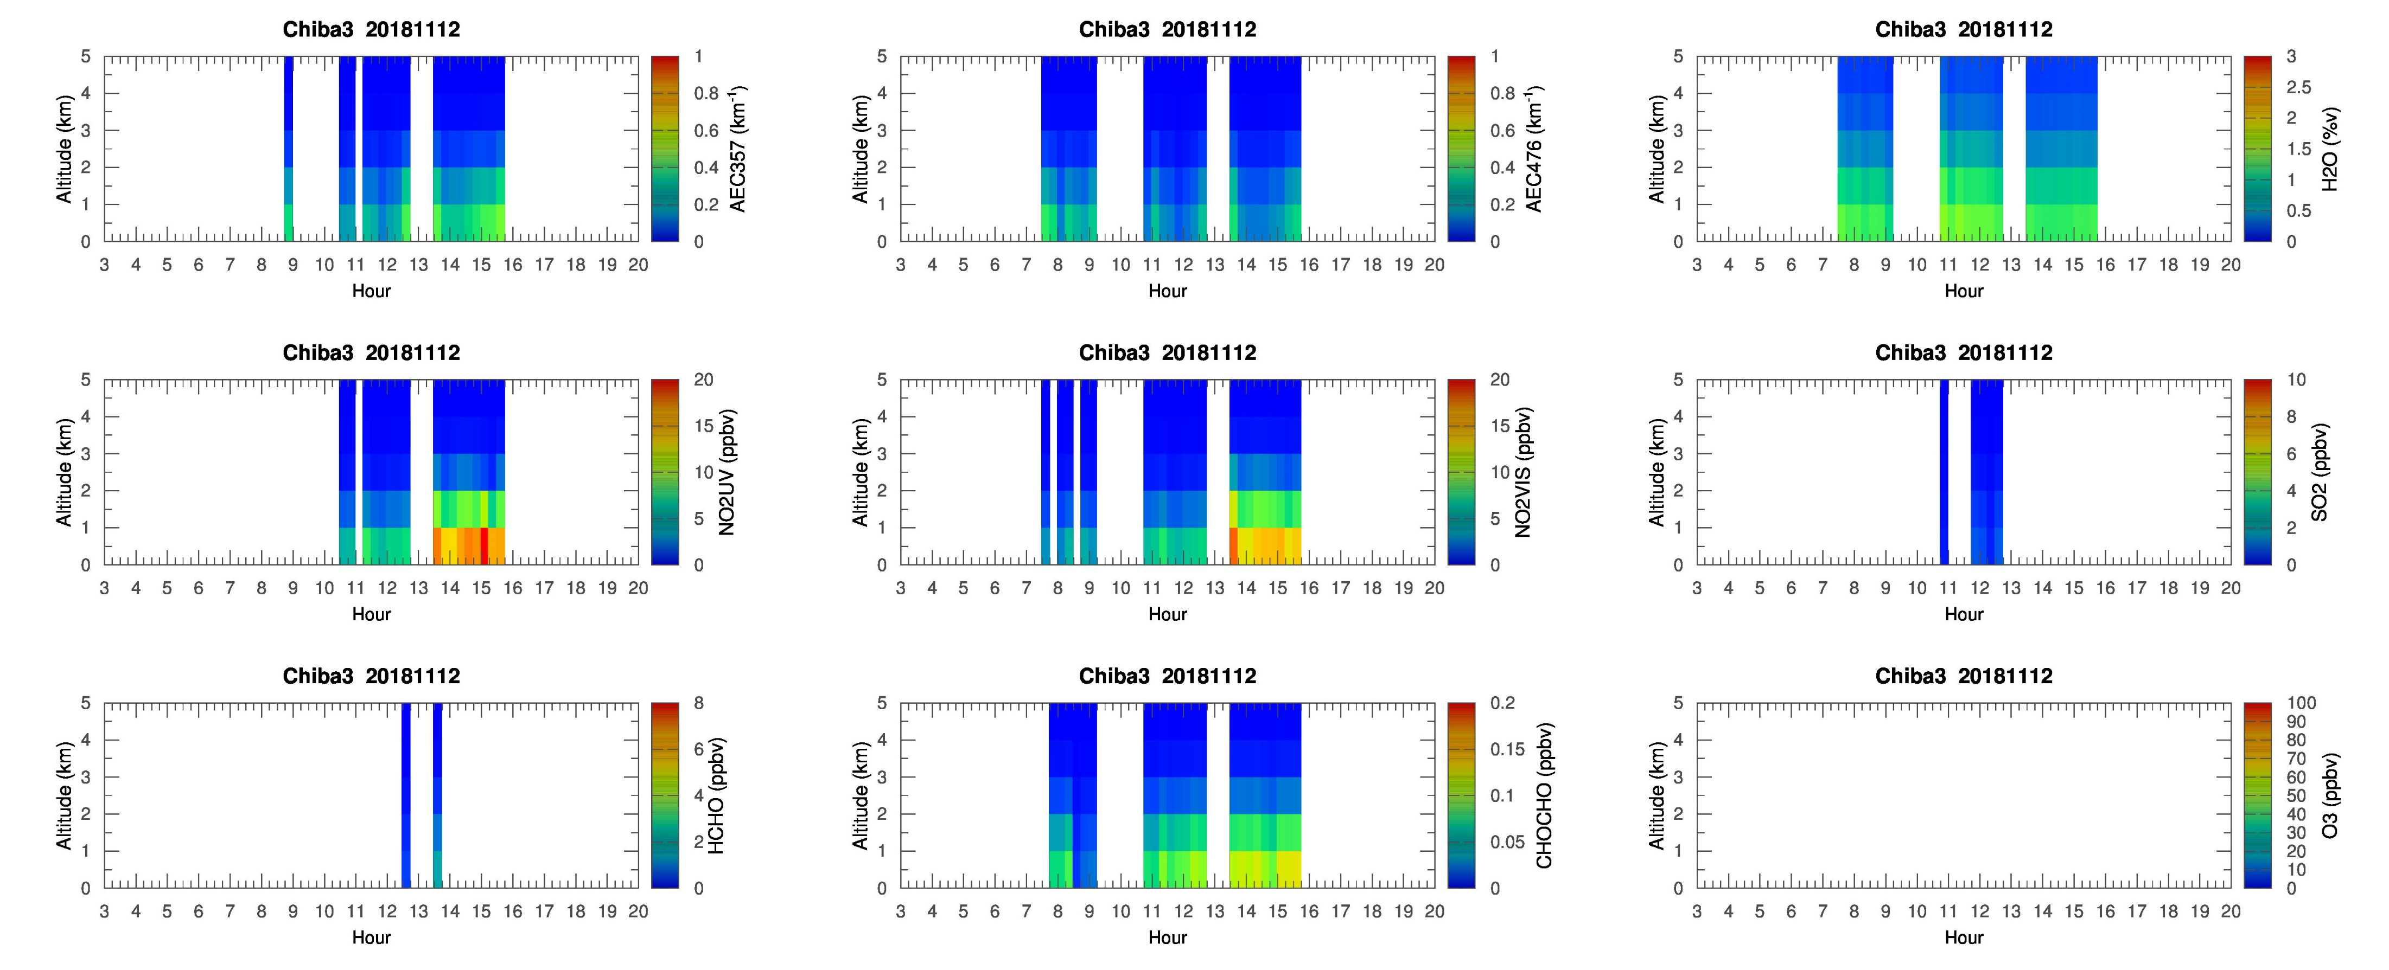
max_chiba3_20181112_ddm1

Slide 7
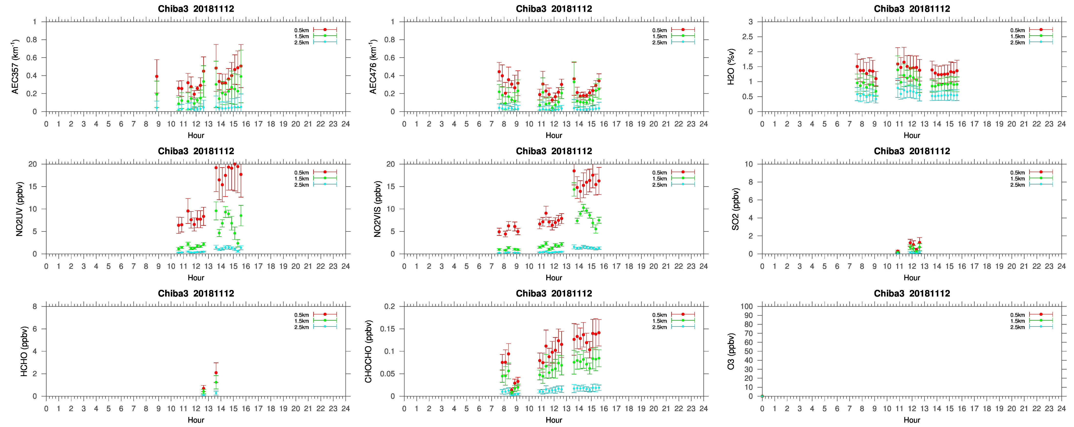
max_chiba3_20181112_dem1

Slide 8
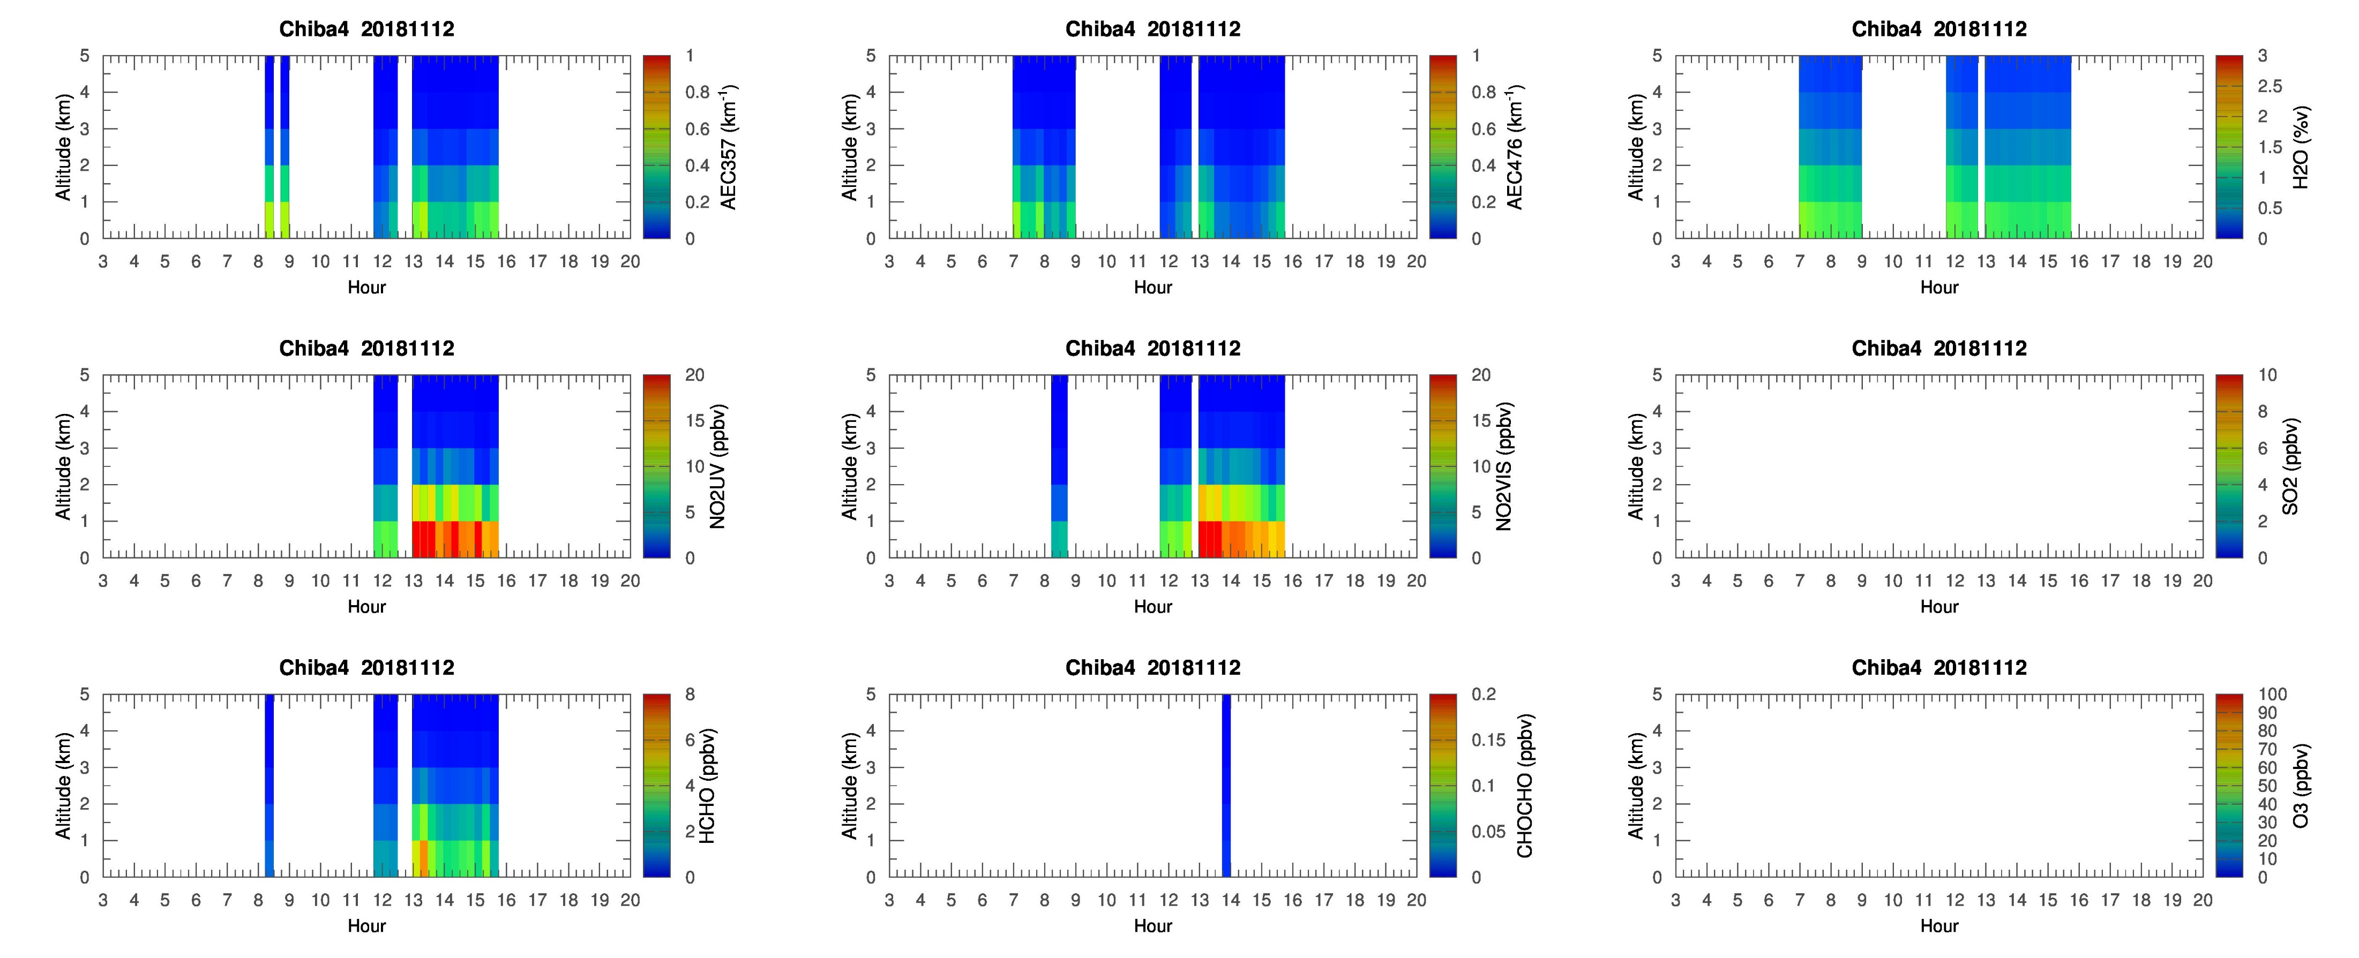
max_chiba4_20181112_ddm1

Slide 9
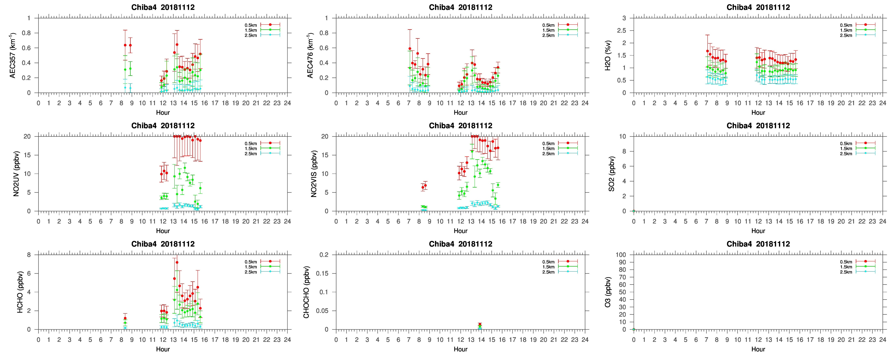
max_chiba4_20181112_dem1

Slide 10
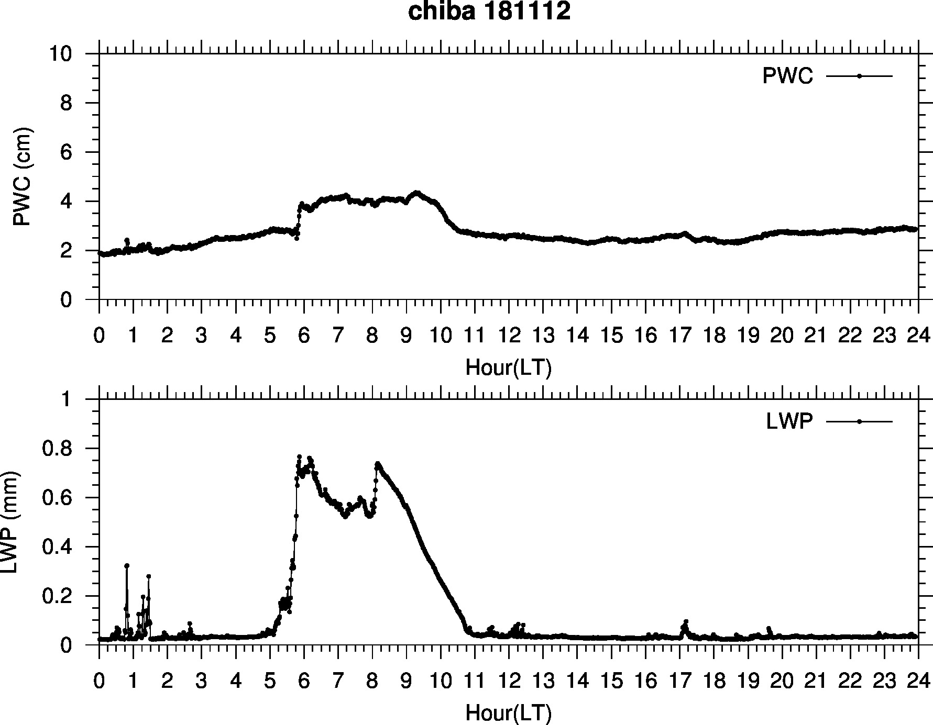
mwrchiba20181112

